Slide 1


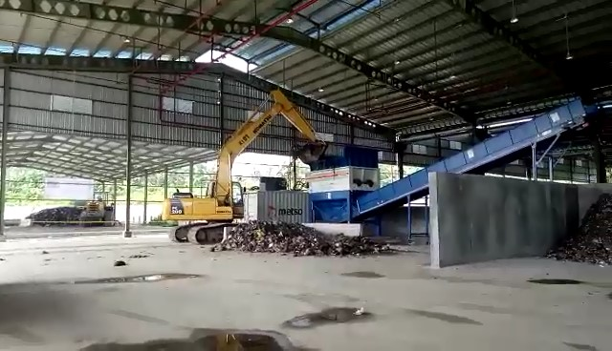
WASTE MANAGEMENT
BY
Mahmoud Mansour Ahmed Abd All Allah
Mohamed Adel Youssef Khaled
Mohamed Hussin
Dr. Aml Mahmoud

Slide 2
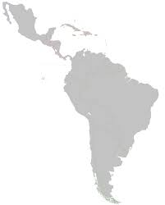
OUTLINE
Problem Statements
The Vision of Solid Waste Management
Existing Condition
Actions

Slide 3
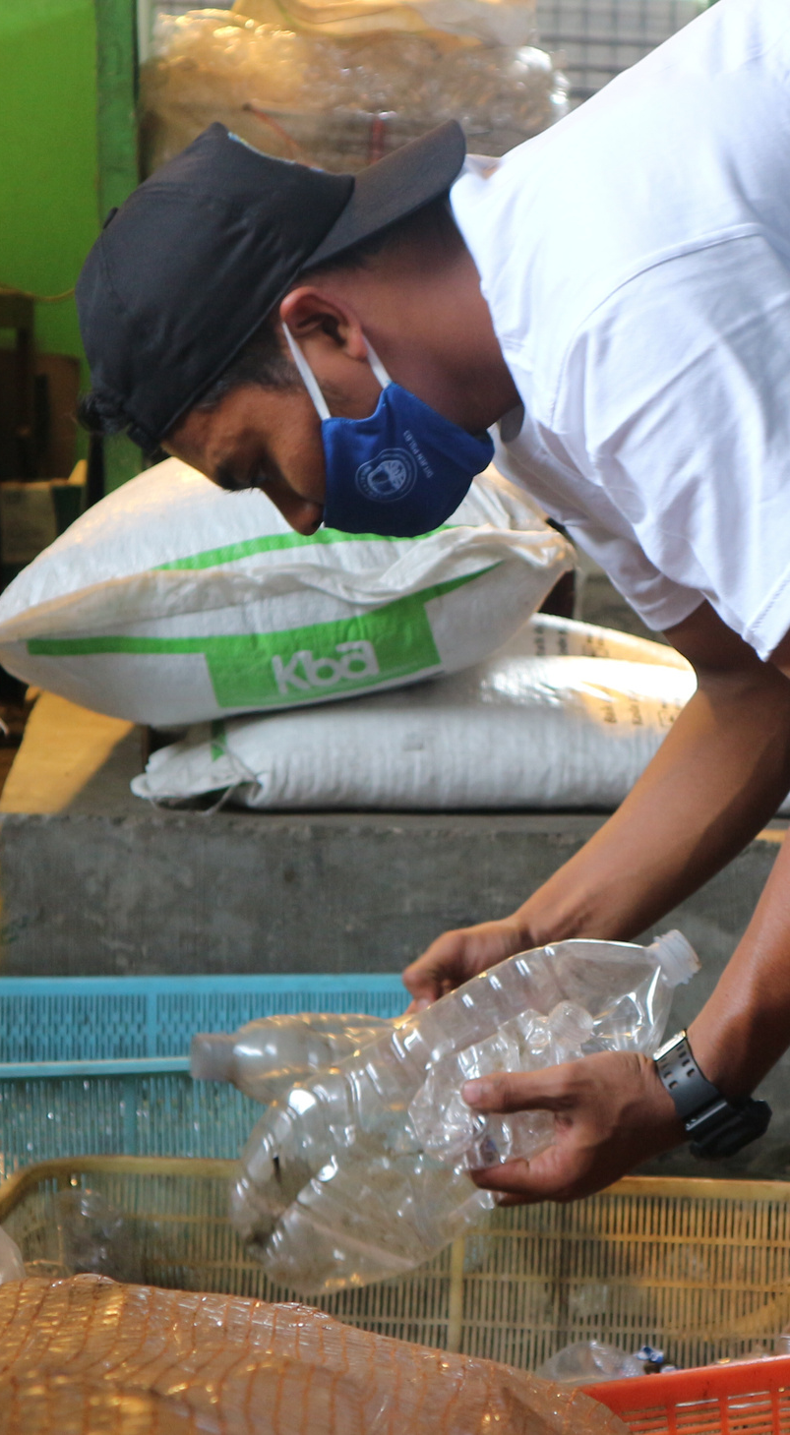
TIMMERMAN INDUSTRIES
PROBLEM STATEMENTS

Slide 4
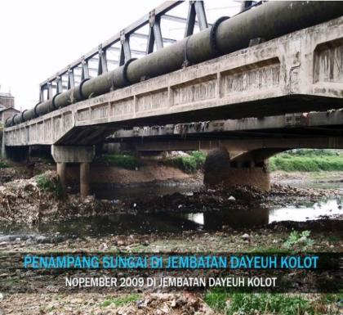
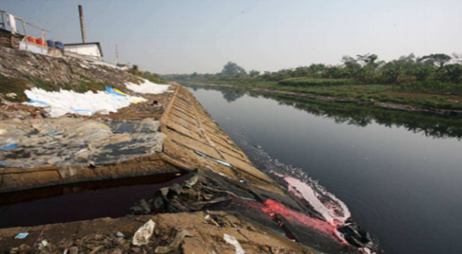
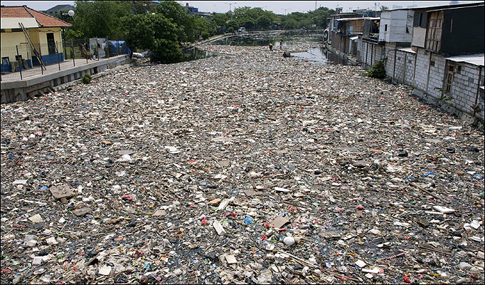
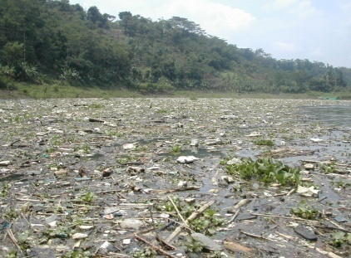
PROBLEM STATEMENTS
Solid Waste Management is not a Priority Sector for Local Government
An average of around 50-70% of solid waste is still being transported and dumped in landfills
Insufficient Waste Management Budget
Sanitary Landfill Investment is not Attractive to Local Government
11

Slide 5
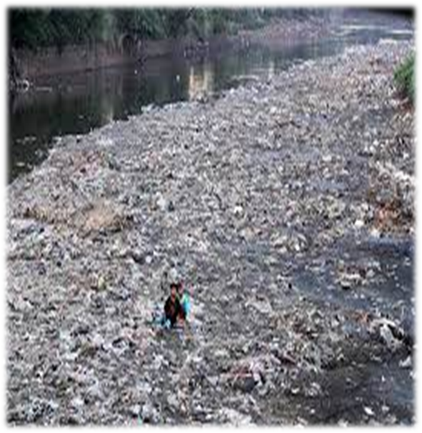
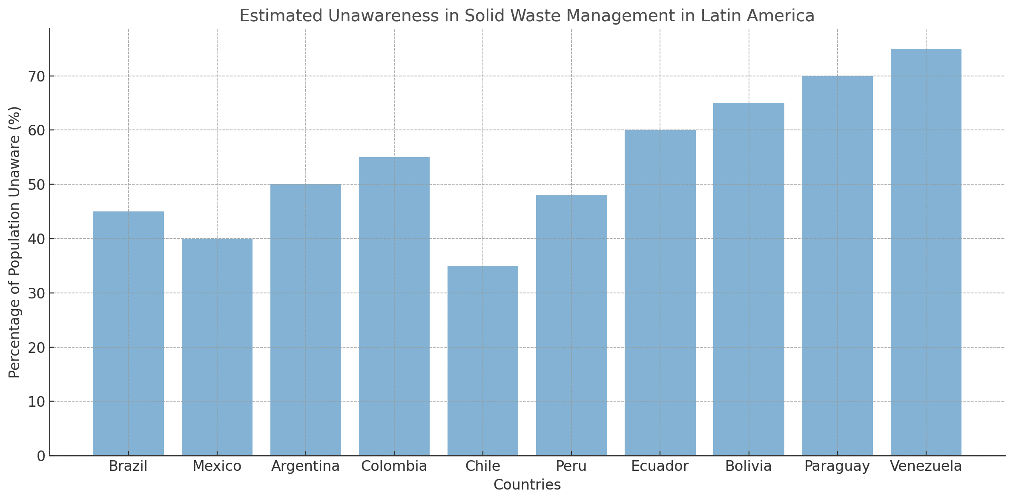
THE INDEX OF PEOPLE UNAWARENESS IN SOLID WASTE MANAGEMENT

Slide 6
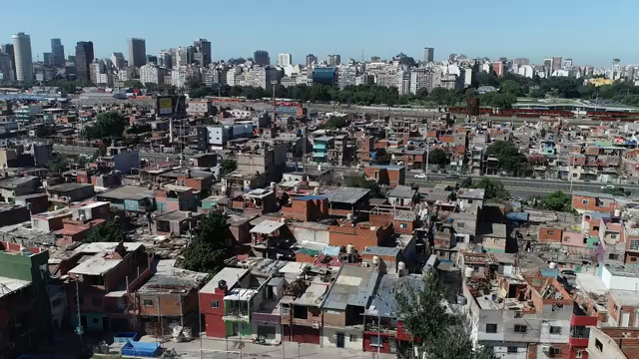
THE INDEX OF PEOPLE UNAWARENESS IN SOLID WASTE MANAGEMENT
Source : https://www.youtube.com/watch?v=izqRkoO1Plk

Slide 7
TIMMERMAN INDUSTRIES
THE VISION OF SOLID WASTE MANAGEMENT IN

Slide 8


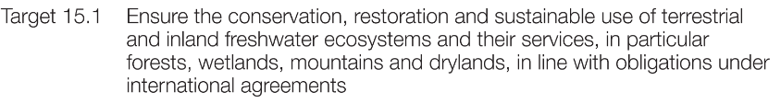
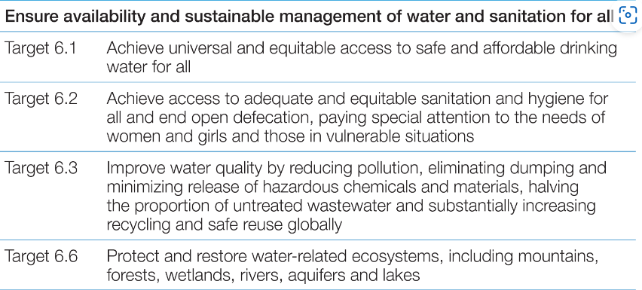

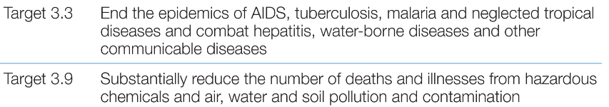

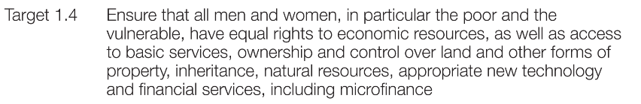

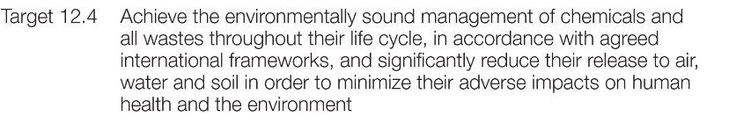
THE INTERNATIONAL OF WASTE MANAGEMENT AND SDGs
Undang-Undang
No.18 Tahun 2008 Tentang Pengelolaan Sampah
Source : The global water quality challenge & SDGs (unesco.org

Slide 9
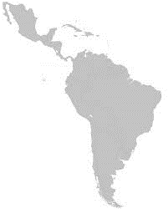
THE NATIONAL OF WASTE MANAGEMENT AND STRATEGY
Latin American Environmental Regulatory Tracker lists pending and recently enacted environmental laws and regulations in several Latin American countries which targets a 30 percent waste reduction and a 70 percent improvement of waste handling by 2019.
Waste Reduction
Reducing waste generation.
Promoting Reuse and Recycling activities at waste sources.
Target by 2019
Waste Handling
Improving waste sorting.
Reducing the amount of waste transported to final processing.
Increasing the amount of waste transported to the waste processing center.
Increasing the amount of waste processed into raw materials and energy sources.
Projected waste generation | (100%)
Waste Reduction Target | (30%)
Waste Handling Target | (70%)
Undang-Undang
No.18 Tahun 2008 Tentang Pengelolaan Sampah
100% of Waste is Managed
https://www.bdlaw.com/publications/latin-american-environmental-regulatory-tracker-32/

Slide 10
TIMMERMAN INDUSTRIES
EXISTING CONDITION

Slide 11

NATIONAL SOLID WASTE MANAGEMENT PERFORMANCE
Waste Reduction
Waste Handling
MANAGED WASTE IN
2019

Slide 12

CONDITION OF LANDFILLS
LANDFILL CONDITION IN 2019
66.37%
OPEN DUMPING
Source:

Slide 13
TIMMERMAN INDUSTRIES
ACTIONS

Slide 14
IMPROVING REGIONAL WASTE MANAGEMENT CAPACITY
1
2
3
4
Developing The Industrialization of Waste Management
State Budget and Special Allocation Funds Support
Implementation Program as an instrument to encourage local governments to increase their waste management capacity
Private sector and international donors support

Slide 15


Slide 16

Any question

Slide 17
Thank you

